Slide 1


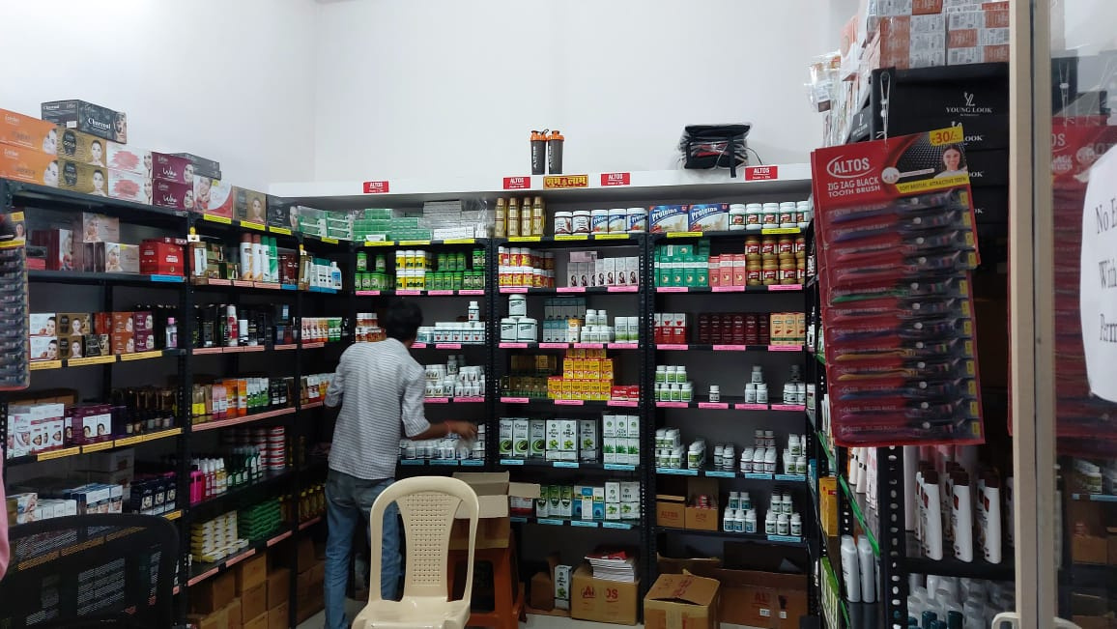

Business data management
CAPSTONE PROJECT
Direct sell Precision:
Data Driven Strategies For Altos
Name = kunal kawadkar
Roll no =23f1000642
email = 23f1000642@ds.study.iitm.ac.in

Slide 2
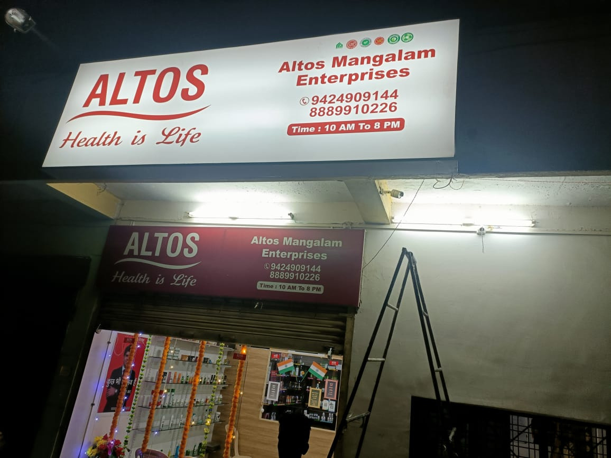
Overview
Executive summary
Data collection and cleaning
Data Analysis
Findings
Recommendation

Slide 3




Executive summary
The business data I have collected belongs to an exclusive store selling ayurvedic products produced by ALTOS company. The business shop name is “Altos Mangalam Enterprises” which is located at Chhindwara, Madhya Pradesh.
With four employees who work around the clock and are consistently honest in their provision
The following reasons explain my motivation behind selecting this business
I have been a frequent customer of this business
I can speak on call with the business owner frequently to get my questions answered.
current situation
Implitation plan
I found that the store was doing well after having a thorough conversation with the owner, but that certain products required specific conditions, leading to a loss of revenue from these products. Products such as agriculture aid and health care have fluctuations in demand and product expiry is a common issue for these products.
Details about the methods used with justification.
Details about the intended data collection with justification
Details about the analysis tools with justification

Slide 4
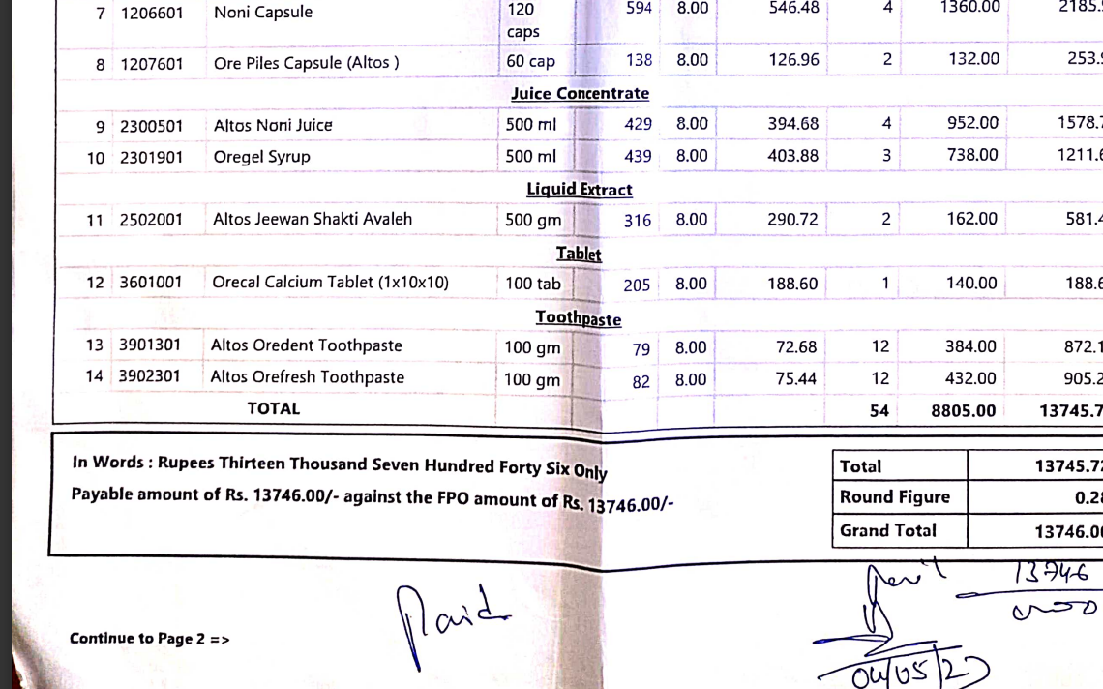

Data collection and cleaning
For thirty to forty days, the data was gathered. The information is seven to eight months out of date.
Since business is GST registered. All sales are monitored and data collected in pdf, excel formate.
For data cleaning and further analysis, Google Collab was utilized in order to consolidate and for visual the representation PowerBI is Used. .
Raw Data collection in PDF form

Slide 5
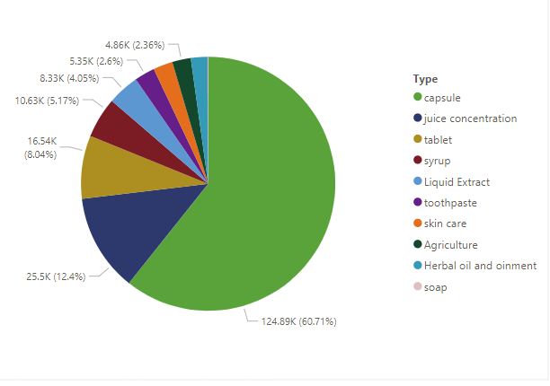
Data Analysis of sales
Calculating of the overall sales on a daily, weekly, and monthly basis to identify recurring patterns and developing trends in the sales information.
To commence the sales analysis, the 'Model Name' and 'Daily Earning' of the dataset are reviewed. The popularity and income contribution of categories can be understood by combining and summarizing the daily revenues for each product. By guaranteeing that the shop stocks various product categories according to customer demand, this study serves as a basis for strategic marketing and inventory management, which in turn improves sales performance.

Slide 6

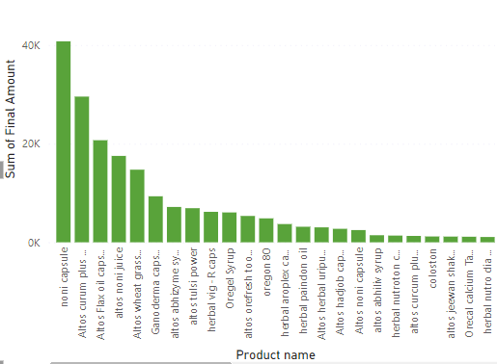
Product sales analysis
Product sales : It's important to comprehend each category's sales in addition to its revenue domination. Even if most of the sales comes from the medical(capsule, table, syrup) category, it's important to evaluate sales margins and their contribution to total profitability.
Highest Revenue Product Identification: The product in the product portfolio that generates the most revenue is the noni capsule (40k), which is indicated by the tallest bar in the graph.

Slide 7

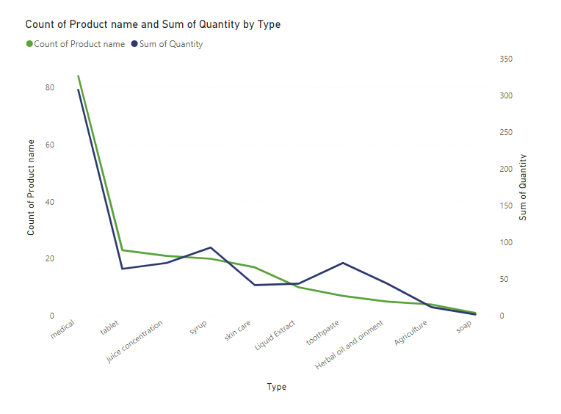
Financial Analysis of sales
Total Sales: Altos Mangalam Enterprises brought in a total of Rs. 2,05,711.60 in sales revenue over the reporting period.
Total Profit: For the reporting period, Altos Mangalam Enterprises made a profit of Rs. 1,15,105
Total Expenses: Altos Mangalam Enterprises incurred Rs. 90,606.60 in total expenses. These expenditures cover a range of operating charges, including rent, utilities, marketing, raw materials, and administrative fees.

Slide 8
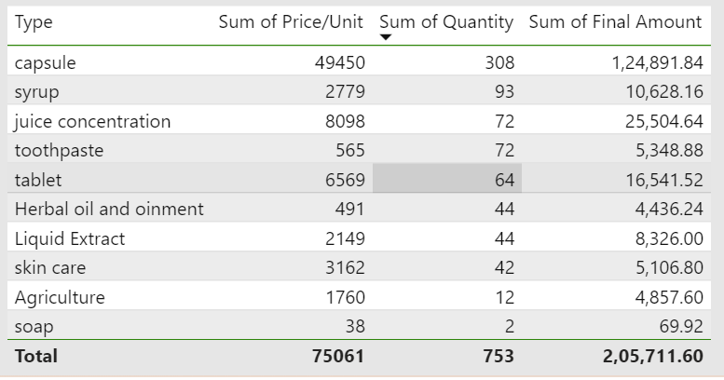

Finding (PL and insights)
The medical category generates a total revenue of Rs. 1,24,891.84, while all categories add up to a total of Rs. 2,05,711.60.
The gross profit in this instance is Rs. 82,284.64. The method for calculating gross profit is as follows: {gross profit = total revenue - cost of goods sold (COGS)}.
The total sales revenue of is Rs. 2,05,711.60,Despite strong sales, a total of Rs. 90,606.60 in expenses were incurred, including Rs. 82,000 in labour costs.

Slide 9


Optimization of Pricing
Promotion and Exposure
Final Recommendations
Inventory Control
Partnership and coorpartions
Client Perspective

Slide 10


THANK YOU
For watching this Presentation

